Slide 1
WA1 – Web Abstractions & Front-End: HTML
COMP 256 – Dickinson College
Prof. Braught
Spring 2023

Slide 2
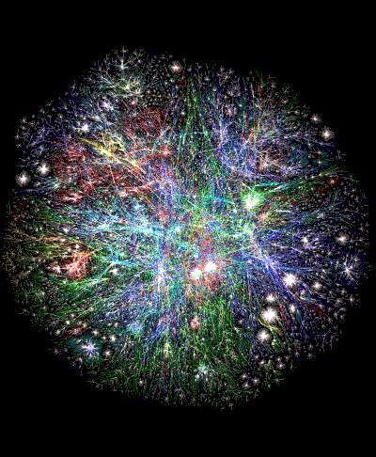
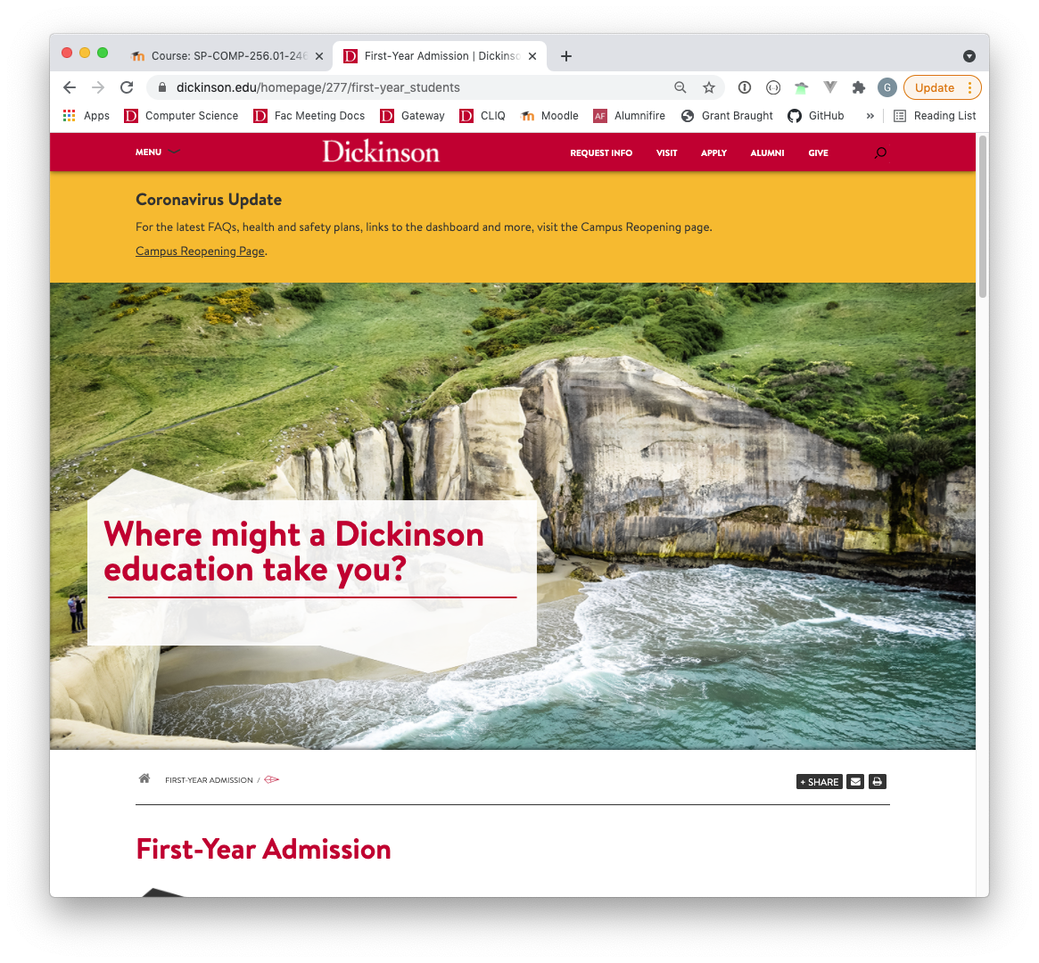

Web Abstractions
Image from: https://vistapointe.net/
web-world-map.html
Photo by: Steven Gerner, https://www.flickr.com/photos/
sgerner/16477700444/in/photostream/
Notes:
Enter a URL into the browser
Get a page back that we interact with
There is a lot that goes on in between
This is a topic, unlike most of the others, where I expect that there is a wide range of different levels of experience with this stuff among you.
- Some of you may not of have done any web development
- Others may have seen some
- HTML / CSS / JS
- Others may have made complete web applications.
I will be assuming only that you have used a web browser.
- so some may be review, that’s ok
- hopefully you still learn a little
But also, we’ll be coming at it from a different perspective than you likely have before.
- The objective is not to teach you how to be a web developer
- Yes you’ll be making web pages and some other aspects of web applications
- But like our other topics, the idea is not to master these ideas
- Instead, the objective is for you to see how abstractions fit together to make web applications work
- To understand conceptually what that parts are and to build an intuition about how web applications work
- then later that will help you as you learn more about them
- either in classes (COMP 190-290) and on your own.
- this will also help you if you go on to create your own web abstractions.
So we’ll be building little pieces of a web application
- Just enough to see each of the major parts and how they fit together.
- A little bit of HTML – lots more to learn later
- But just enough to understand what HTML is and the role that it plays.
- A little bit of CSS/JS/Database/Etc…
- Again, just enough of each of them to know what their role is and how they fit together to make a web app.

Slide 3
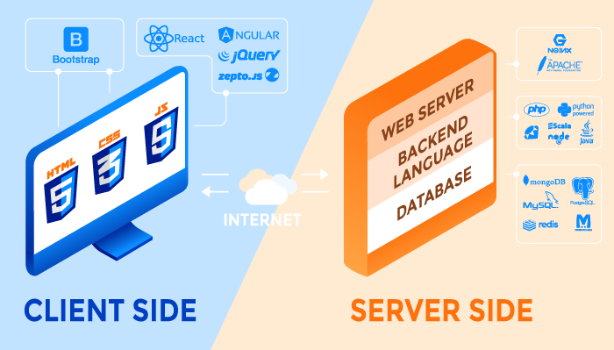
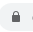
Typical Elements of a Web Application
http
https
Front
End
Web APIs
Back
End
Image from: https://rubygarage.org/blog/technology-stack-for-web-development
Notes:
Web Apps are generally divided into two parts
- Client side or front end
- Sever side or back end
The Client Side – Front end
- This part of the app runs on your machine within your web browser
- It is what you see when you use the web.
- Based on three fundamental languages
- HTML
- CSS
- Javascript
- Everything else listed – which you may or may not have heard of (doesn’t matter)…
- Bootstrap, React, Angular, JQuery, etc…
- Those are just software libraries or frameworks.
- They are abstractions built from HTML/CSS/JS that make it easier to construct large applications.
- The relationship is similar to that between a HLL and its libraries.
- These libraries aim to make it easier to create rich interactive web applications
- They hide details that the developer doesn’t’ need to worry about
- Which lets the developer focus on the parts they do need to worry about.
- We will only briefly look at one library (Bootstrap) to get a feel for libraries as abstractions.
- we will instead focus on the fundamental elements (HTML/CSS/JS) that are used to build them.
- this will give you flexible foundational knowledge that is applicable to all of the different libraries and frameworks.
- you’ll see more and learn about Vue.js (a different framework/library) in COMP 290 if you have not already taken it.
The Server Side – Back End
- These are programs that run on a web server somewhere else on the internet
- When you enter a URL in your browser and that request makes its way to the server these are the pieces of software that run on that server to gather information, created the page and it back to you.
- Typically, the back end is made up of three main components
- The Web server
- A Backend Language
- A Database
Note that the term Web Server is overloaded:
- The machine connected to the internet that runs the back end software is called the Web Server (hardware)
- The program that runs on the Web Server (hardware) that processes requests for pages or information is also called the Web Server (software)
- Generally, you’ll be able to tell from the context if the term Web Server is referring to the hardware machine or the software program.
Front end clients are connected to backend servers over the internet
- HTTP / HTTPS – the language used by front end applications to request pages or information from the back end.
- HTTPS – the S is for secure, meaning that the information sent between the client and the server is encrypted.
- Web APIs use HTTP/HTTPS to request information rather than web pages.
- There will be more on this as we continue on.

Slide 4




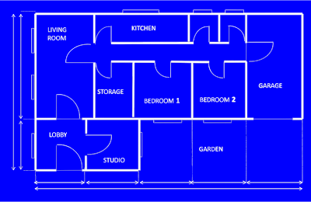

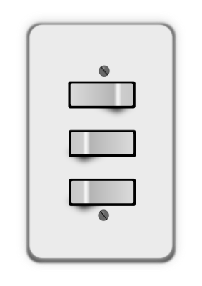

Fundamental Front-End Technologies
HTML – Hypertext Markup Language
Specifies structure and content
CSS – Cascading Style Sheets
Defines presentation and style
JavaScript
Provides action and Interactivity
Images from: openclipart.org
Notes:
HTML / CSS / JavaScript are the three fundamental languages/technologies used on the font end.
HTML Specifies the content and structure of a page
- What words, images, links, buttons, etc appear on the page and how they are related to each other.
- It can also specify to some extent also where things are on the page in relation to each other.
- It is sort of like a blueprint for a house
- What rooms are there, what windows and doors are there, what fixtures (sockets, lights) are there?
CSS Specifies how those contents appear on the page
- What colors are used, what buttons look like, where things are positioned on the page.
- This is like interior decorating
- What color are the walls?
- Where are the pictures hung? What frames are they in?
- Where is furniture placed? What fabrics are used to cover it?
JavaScript makes the page active and interactive, it makes it do stuff other than just display information.
- Actions that happen when you click a button, animations, page changes, etc.
- This is like the electrical wiring and plumbing in the house
- It connects the things you see to each other so that actions make things happen.
- Like connecting a light to a light switch.
- Without it the light sits there and looks pretty, but it doesn’t turn on when you flip the switch.
- Like the plumbing.
- Without it the faucet looks nice, but nothing happens when you turn it on.
Look at the Class Schedule Search page in SSB in the Gateway for an example:
- Browse Classes
- https://bannercprod.dickinson.edu/StudentRegistrationSsb/ssb/term/termSelection?mode=search
- HTML
- Dickinson workmark image
- Links to “Student”, “Course Requests/Registration”, “Select a Term”
- “Select a Term” text
- Dropdown menu for terms
- “Continue” button
- etc…
- CSS
- The Font used
- The particular way the button looks as compared to other pages.
- The gray/blue border around the page
- JavaScript
- Populate dropdown when it is opened
- “Searching” when the dropdown is first clicked is JavaScript asking the server for the data to show.
- This is done via a Web API that was mentioned earlier.
- Changes the page when the button is clicked

Slide 5
Fundamental Back-End Technologies
Web Server (software)
Program that accepts requests (via http/s)
Returns requested content
Back-End Language / Application
Programs that can be run by the web server to generate requested content.
Database
A program that provides efficient access to information used by back-end programs to generate content.
Notes:
The fundamental back end technologies that are used include:
The Web Server
- Here we are talking about the software web server.
- This is a program that runs on the web server (hardware/machine)
- Receives requests for pages or data from web browsers (or other programs)
- Requests come in over the internet in the HTTP/HTTPS language.
- The server finds the requested page/data and returns it to the server over the internet.
The Back-end languages or Applications
- These are programs that can be used by the web server to generated the requested page/information.
- Called “Back end language” because some language is used (e.g. JavaScript, Python, Java, etc).
- So back end applications are written in the back end language.
- Not all requests require use of back end applications
- A request for a plain old web page will not
- The web server can just open a file and provide that page back to the requesting browser.
- But requests for complex pages with dynamic information will use back-end applications to generate the page/data that is returned.
The Database
- Many applications make use lots of data to create their pages
- The page for course search that we looked at for example
- the list of terms or classes that exist are stored in a database
- A backend program retrieves those and generates the content that is displayed (e.g. in the dropdown).
- The database is a program that runs on the server and allows the back end programs to access that data in efficient ways.
- The backend program will
- ask the database for the data it needs to handle a request
- it will then organize and process that data so that it meets the request
- it will then either hand it back to the web server or return it directly to the requestor.

Slide 6

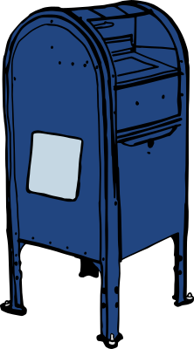

The Connections
HTTP – HyperText Transfer Protocol
Request: Sent from a browser to server to ask for a page or information.
Response: Returned from the server to the browser to provide the requested information.
Web API
A well-defined set of requests that a specific web server can satisfy.
Images from: openclipart.org
Notes:
The connections between the front end and the back end are communicated over the internet using HTTP.
- HTTP consists of two main pieces
- The Request
- A packet of information sent from the client (e.g. browser) to the server (e.g. web server software)
- This packet specifies what page or piece of information is being requested.
- E.g. https://www.dickinson.edu
- This requests the main homepage from the www.dickinson.edu site.
- E.g. https://www.dickinson.edu/~braught
- This requests the main page from professor braught’s professional website.
- The Response:
- Packets of information that are sent from the web server back to the client.
- These packets contain the information that was requested.
- The client (e.g. the browser) will interpret or process that information
- E.g. the browser will display the web page for the user
- HTTP is a protocol.
- We can just think of it as a specific format for sending and receiving information.
- That way when the browser sends a request it knows that the server will understand it.
- And when the server returns a response it knows that the client will understand it.
We can think of this using a Metaphor:
- It is like sending a letter and getting a response
- Browser writes up its request (HTTP)
- puts it in the envelope with the address of the server
- puts it into the mail/post
- i.e. sends it over the internet.
- Post system delivers that without knowing what’s inside
- Internet doesn’t know anything about HTTP or web pages
- same as postal system doesn’t know what’s in your letter.
- it just transfers it.
- Recipient (web server) opens the letter
- processes the request (web server software understands the request)
- writes a response (a web page or data)
- puts it in an envelope
- addresses it back to the browser
- puts it in the post to send it back.
- web browser understands the response and renders or otherwise processes it.
- As long as both the client and the server know the language that is being used on the letters everything works.
API Metaphor
- API is like a standard form that you might put in the envelope to send to a particular company to order something.
- We used to do that back in the day
- if you wanted to order a record – you sent the request to the record seller
- that seller had a specific form you would use to place the order. The company understood that order form.
- if you wanted to order a computer – you sent the request to the computer seller
- that seller had a different form that it understands.
- If you were to send the wrong form to the wrong place , you would get an “error response” telling you the message was not understood.
- Same with APIs
- when my browser talks to the Amazon API it can use a certain set of commands that Amazon understands
- those are different commands than if the browser is talking to the Twitter or YouTube or Weather API.
- The front end application knows what API it is talking to, so it knows what commands to use (i.e. which form to fill out).

Slide 7
HTML: HyperText Markup Language
Notes:
Today we’ll dig into HTML a little.
Then next class CSS
And so on until we have seen just a little bit of all of the parts of a web application.

Slide 8
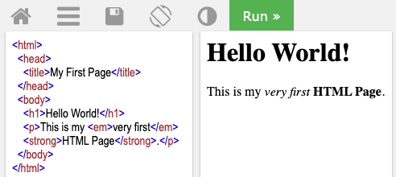
An HTML Document (a.k.a. a Page)
HTML
Source
Code
Rendered
HTML
Editor at: https://www.w3schools.com/html/tryit.asp?filename=tryhtml_basic
Notes:
An HTML document is a text file that contains the source code for a web page.
- This source code uses tags to create elements that define the structure and content of the page.
- A web browser then uses that structure and content to display (i.e. render) the page.
The source code for the page contains “Elements”
- Each element corresponds to some
- content in the page (<h1>)
- or some information about the page <title>
For example:
- The <h1> element is a heading:
- the h1 stands for heading level 1 – or first level heading
- Because “Hello World!” appears between the <h1> opening tag and he </h1> closing tag it is identified as being a first level heading
- By default most web browsers will renders h1 elements using a large boldface font.
- we’ll see how to control (or style) the way things are rendered next class when we look at CSS.
Code for copy paste:
<html>
<head>
<title>My First Page</title>
</head>
<body>
<h1>Hello World!</h1>
<p>This is my <em>very first</em>
<strong>HTML Page</strong>.</p>
</body>
</html>

Slide 9
HTML Elements
Opening
Tag
Closing
Tag
Content
Element
Notes:
Now we’ll turn our attention to some more detail on each of the main elements.
- Like with other things, we will not cover them in their full detail
- But you’ll learn enough to see how they are used and how they connect.
- Today HTML
An HTML document is made up of a collection of “elements”.
Most elements are defined by an:
- Opening tag – indicating the start of the element.
- Sometimes the opening tag is also called the Start Tag.
- Closing tag – indicating the end of the element.
- Sometimes the closing tag is also called the End Tag.
- Content – the content of the element.
- This is some text that appears between the opening and closing tags.
- The text in the Opening and Closing tags is not case sensitive.
- So <H1> is the same as <h1> and </H1> is the same as </h1>
- Can even be mixed and matched <h1> </H1>
- Though it is considered good style to be consistent with the way you write them.
Above it says “Most elements…”
- Some elements will only have a single tag
- In those cases, the content will be within the tag.
- We’ll see an example of that a little later.

Slide 10
HTML Elements
Editor at: https://www.w3schools.com/html/tryit.asp?filename=tryhtml_basic
Notes:
There are lots of other elements in this page as well.
- em – an emphasized element
- Most browsers will render this using an italic font by default
- strong – a strong element
- Most browsers will render strong elements using a boldface font by default
The general idea is that…
- You will use tags to “mark up” the content in the source code to indicate what kinds of elements you want.
- The browser then uses that markup (i.e. the elements) to decide how to render the page.

Slide 11
Nested HTML Elements
Editor at: https://www.w3schools.com/html/tryit.asp?filename=tryhtml_basic
Notes:
HTML elements are frequently nested inside of each other.
For example:
- Here there is an em and a strong element that are nested inside of a p (paragraph) element.
This page contains other nestings as well…
- h1 and p elements are nested inside a body element
- the title element is nested inside of a head element.
- The head and body elements are nested inside an html element
Note that not all elements generate content on the page.
- The head element provides information about the page.
- The body element typically contains the content that is rendered into the page.
It is important that all nestings be proper.
- For example, we could move </em> after </strong>
- <p>This is my <em>very first <strong>HTML Page</strong></em>.</p>
- Now the strong element is nested inside the em element.
- How would this change what is rendered?
- However we could not place the </em> between <strong> and </strong>
- <p>This is my <em>very first <strong>HTML</em> Page</strong>.
- This is not a proper nesting because the em element is not fully within the strong element.

Slide 12
HTML Structure (html / head / body)
Editor at: https://www.w3schools.com/html/tryit.asp?filename=tryhtml_basic
Notes:
As we saw many elements (e.g. em, strong, p, etc) will define content that is rendered by the browser.
There are other elements that define the structure of the page and are not rendered.
Every page typically has:
- html element
- this element contains all of the other elements that are in the page.
- that is, all other elements are nested inside the html element.
- head element
- This element provides header or meta information about the page
- This information is not rendered into the page by the browser.
- For example, above the head element contains a title element.
- title element
- The title element specifies the title of the page.
- This typically appears in the browser tab or as the name of a bookmark.
- The head element can have other elements nested in it as well
- we will see some other elements that we can put into the head in coming classes.
- body element
- The body element contains all of the elements that are to be rendered into the page.
- It may also contain some elements that are not rendered.

Slide 13
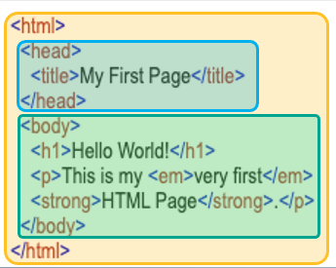
The Document Object Model (DOM)
html
head
body
title
h1
p
My First Page
Hello World!
This is my
em
strong
.
very first
HTML Page
Notes:
The nested structure of the HTMl elements can be represented as a tree.
- The tree is a data structure that the browser uses to represent the document.
- This tree structure is called the Document Object Model (or DOM for short)
The HTML elements appear in the tree based on how they are nested in the source code.
- When elements are nested inside of another element
- They appear below it.
- head and body are inside the html element so they are below html in the DOM tree.
- Title is inside the head element so it is below head DOM tree
- h1 and p are nested inside the body element so they are below the body element in the DOM tree.
- etc…
- Ultimately the content of the elements appear at the bottom of the tree below its element.
- “My First Page” is the content of the title element so it appears below title
- “Hello World” appears below h1
- “very first” appears below em.
- etc…
- Elements at the same level of nesting appear from left to right in the order that they appear in the source code.
- For example:
- h1 and p are nested inside of the body (so they appear below it as described above)
- h1 appears to the left of p because h1 comes before p in the source code.
- Similarly
- em appears to the left of strong because em comes before strong in the source code.
If you have taken COMP 232 you will recognize this structures as a tree
- You might also notice that a depth first traversal will visit the elements in the order in which they should be rendered into the page.
- If you haven’t had COMP 232, no big deal.
- Maybe just keep this example in the back of your mind when you see trees in 232 next fall.

Slide 14

Links & Images
Attribute
Empty Element
No content
No end tag
Name
Value
Notes:
Links and images are HTML elements also.
- Links are created by an a (anchor) element.
- Images are created by an img (image) element
Both Link (a) and Image (img) elements have attributes
- Attributes appear inside the start tag and add additional information to the element
- They might describe the behavior of the element.
- They might also modify the way the element is rendered.
- For link (a) elements
- The href attribute specifies where the link leads
- the attribute name is href
- the attribute value is the URL of the page to go to (i.e. its address)
- the content of the element (Dickinson) is the rendered text of the link.
- e.g. <a href=“https://dickinson.edu”>Dickinson</a>
- attribute name is href
- attribute value is “https://dickinson.edu”
- element content is Dickinson
- For image (img) elements
- The attribute specifies the image to display
- The attribute name is src
- The attribute value is the URL of the image.
- Note:
- the img element does not have any content
- so it does not have an end tag
- Called an empty element.

Slide 15
Our Web Abstractions Container

Slide 16
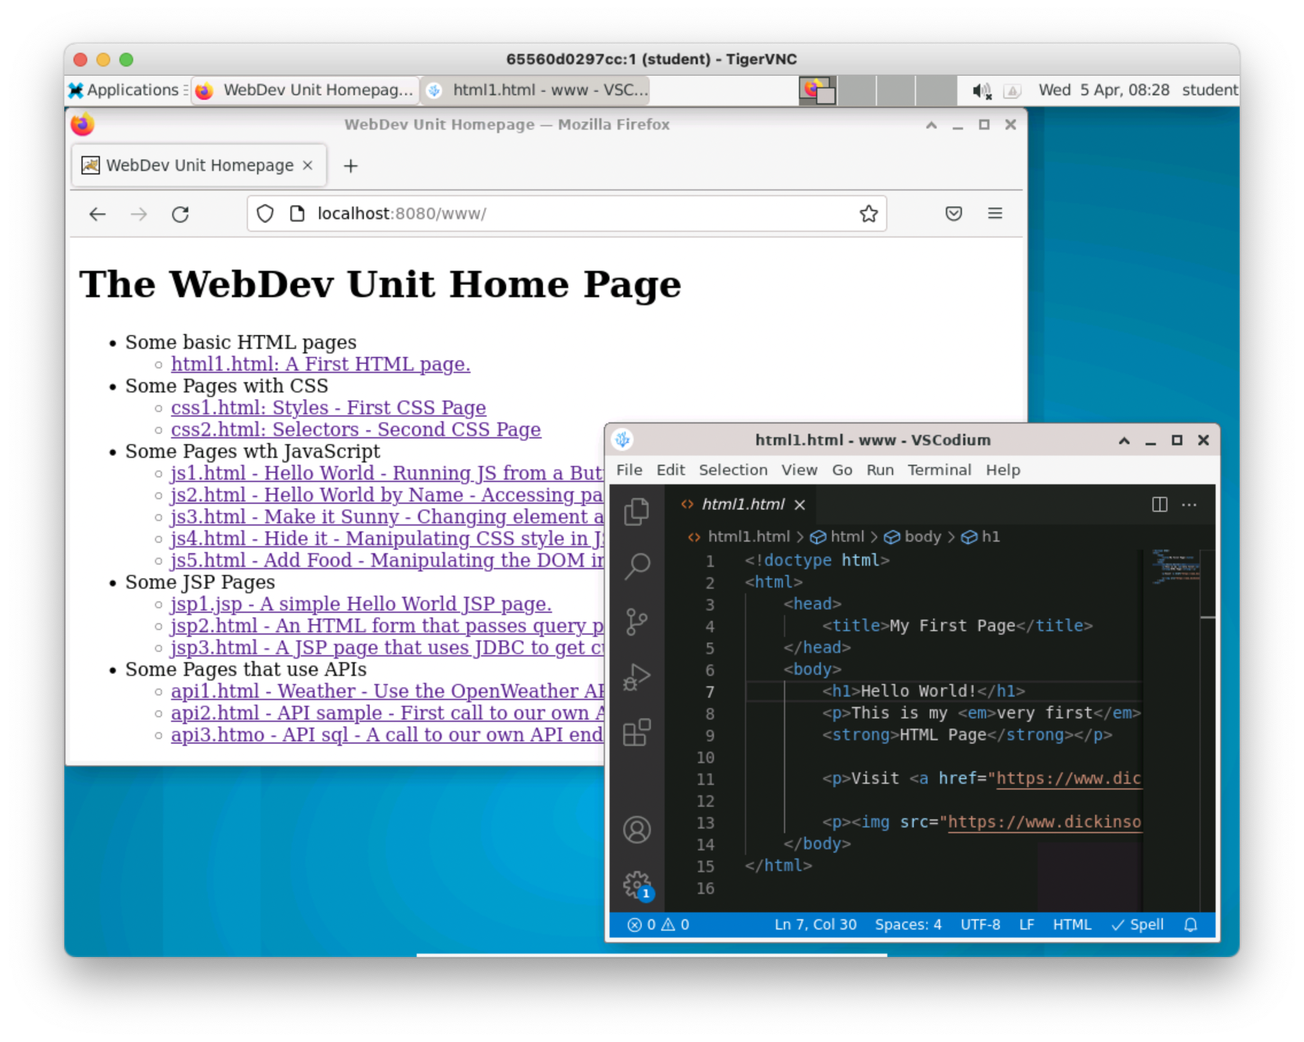
The Comp256Web Container
Back
End
Web Server, API Server and a database are all running in the background in the container.
Front
End
Browser and text editor in the Linux environment in the container.
Notes:
Everything you need for the homework is in the container that is provided.
The instructions for creating the container are included in the homework.
It will look just like our other containers.
It will jut have a different software running.
The main page links to a lot of examples that you will use throughout the unit.

Slide 17

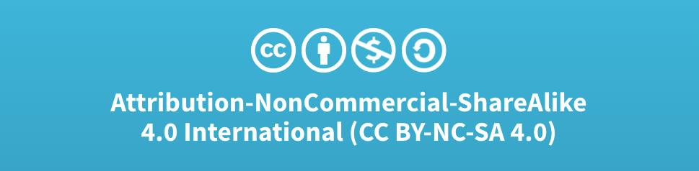
Acknowledgments
Slide Template From:
https://creativecommons.org/licenses/by/4.0/
Slide Content Licensed as:
Creative Commons Attribution-NonCommercial-ShareAlike 4.0 International License.
Notes:
Note: Individual images may be covered by their own licensing agreements and were incorporated here under fair use. Their use in this slide deck does not change or alter their licensing.

